Slide 1



Saint Louis University
MicrobioSee v2.0, a desktop software for microbiome data visualization.
Jinhui Li,
Kaarunya Nachimuthu,
Abdur Rahman Syed Ali
5/7/2024
Notes:
Hi, everyone, this is Jinhui Li,....., Today we will introduce a software…..

Slide 2
Content
Background
Method & Modules
Demonstration of MicrobioSee & Discussion
Notes:
Our report contain three parts.

Slide 3
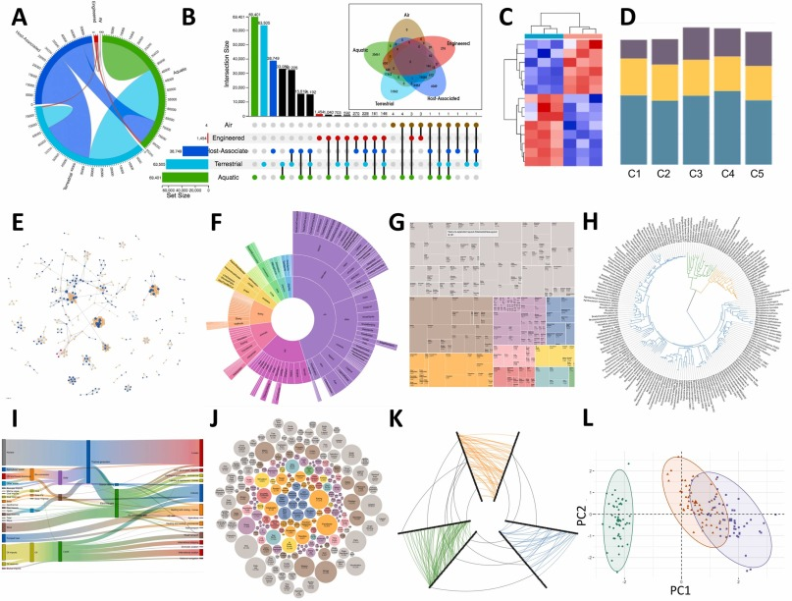
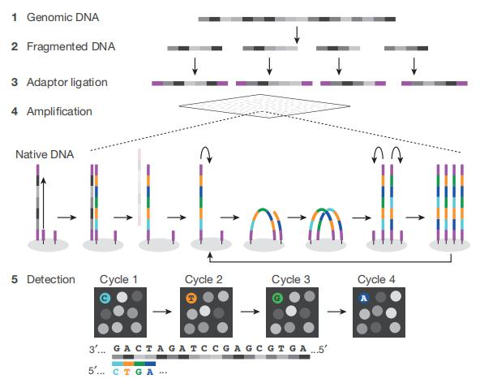
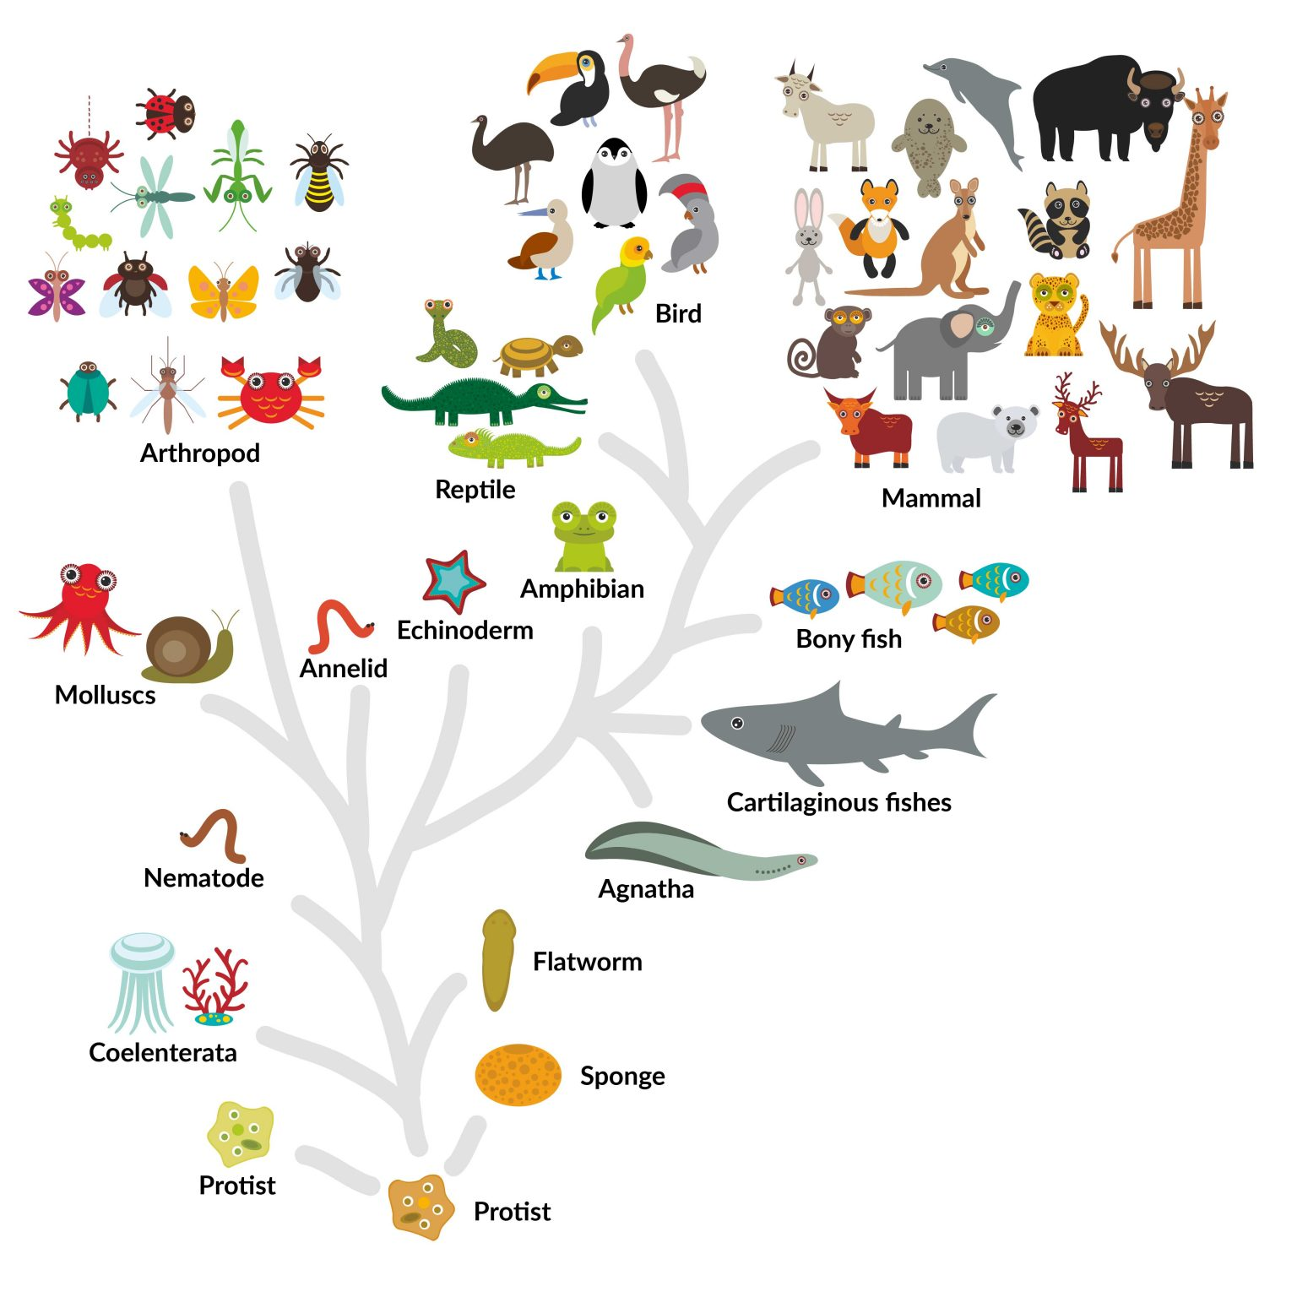

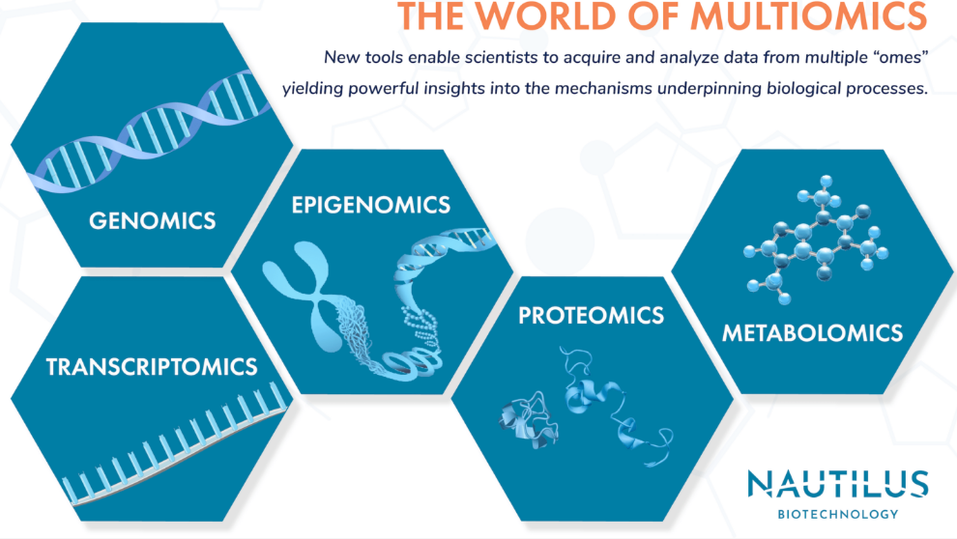
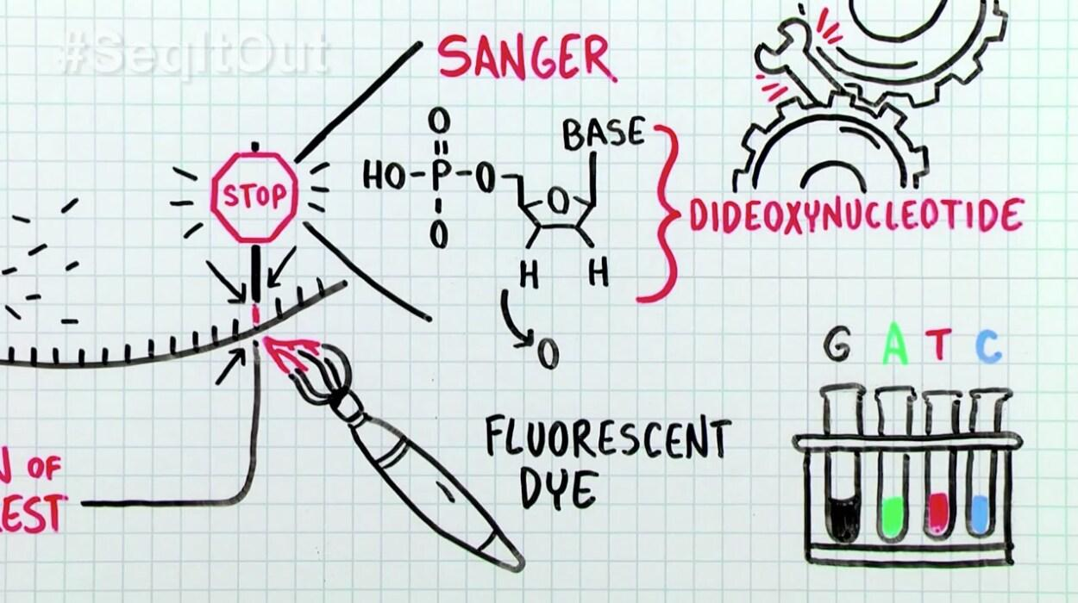
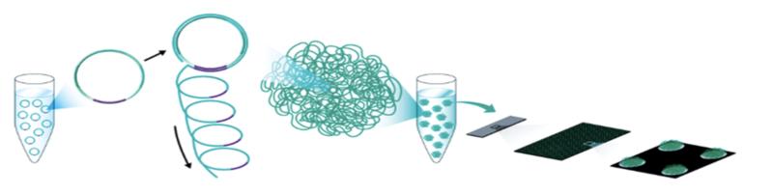
Background
What is a bioinformatics engineer’s main work?
Construct analyze pipelines and run it.
Visualize the result.
Develop the algorithms of mapping and clustering.
Build the database for searchingmapping.
Why bioinformatics are important?
2001
2024
Notes:
There are some questions, first,
Since the HGP, many sequencing techniques has been developed, such as NGS based on bridge PCR or circle PCR. recently, many species has been sequenced, at the same time, multi-omics techniques were brought to vision. therefore，scientist have to look for engineers who can use code to analyze and visualize their data.

Slide 4

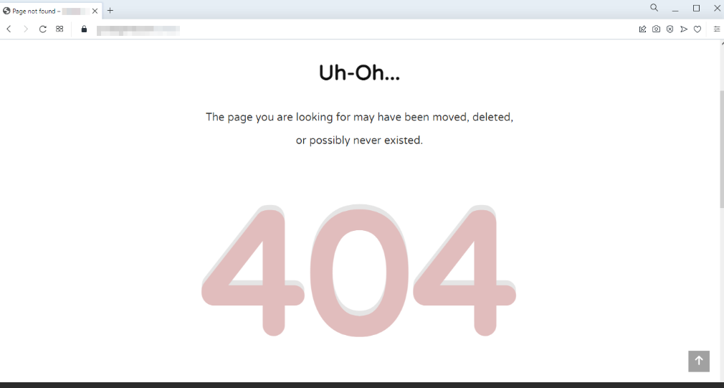
Background
Microbiome plays an important role in personal life.
Many microbiologists can’t master code techniques, include coding for visualization, and developing a tool for visualization of microbiome data is very necessary.
The interactive tools based on web technique that depend on the network and have some visit restriction due to the security policy of management.
Data security. Some scientists don’t want to upload their data in any website before publishing work, such as iDEP.
The desktop tools existed are expensive, such as Origin and GraphPad Prism.

Slide 5


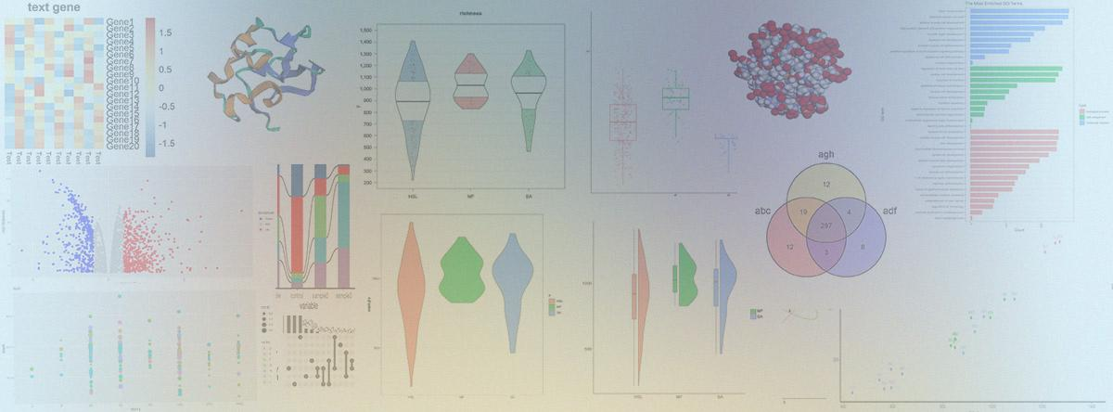
MicrobioSee2 ( desktop version )
MicrobioSee = Microbiome + See
The desktop version contain 12 visualization tools.
Form a developer community in github.
Github: https://github.com/jinhuili-lab/MicrobioSee2
User Guide: https://microbiosee.github.io/
MicrobioSee logo
MicrobioSee2 logo
Notes:
MicrobioSee originate from Microbiology and See.

Slide 6
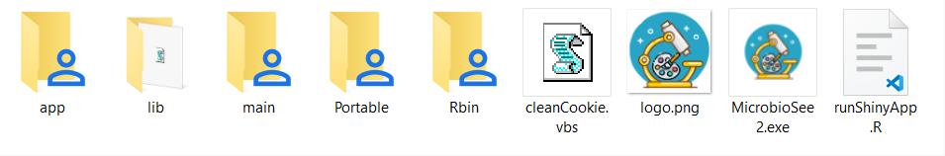
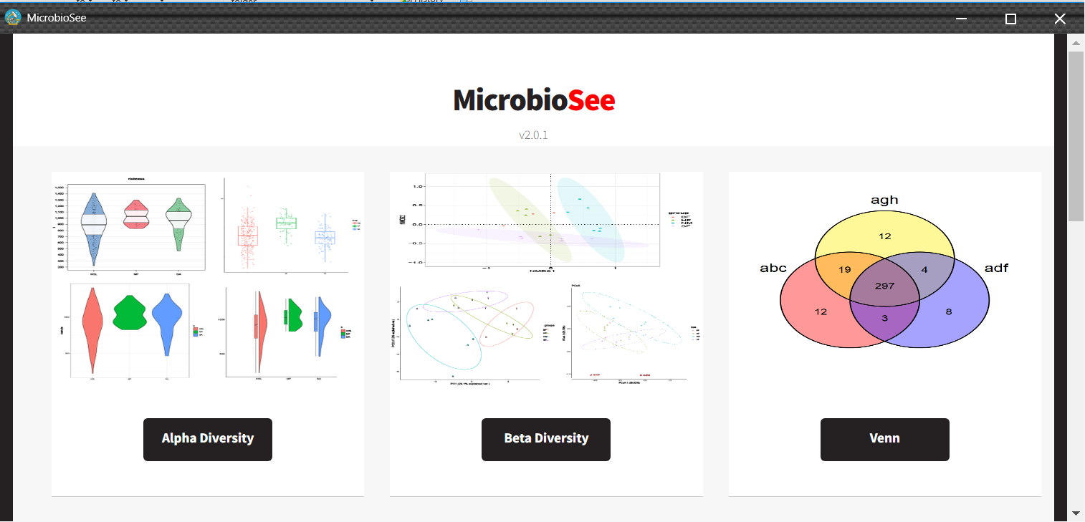
MicrobioSee2
App: modules
Lib: some library file
Main: core program
Portable: dependence
Rbin: R packages
CleanCookie.vbs: Clean cookie
Logo.png: logo png
MicrobioSee2.exe: Executable program and entrance
runShinyApp.R: hook
Shiny + VBS + Chromecore + HTML = Desktop version
Notes:
This is the main files and folders in MicrobioSee2.

Slide 7
Comparative analysis
 | Origin | MicrobioSee v1.3 | MicrobioSee v2.0
Without network dependence | √ |  | √
Responding speed | Faster | depend on network | Faster
Free |  | √ | √
Interactive visualization | √ | √ | √

Slide 8
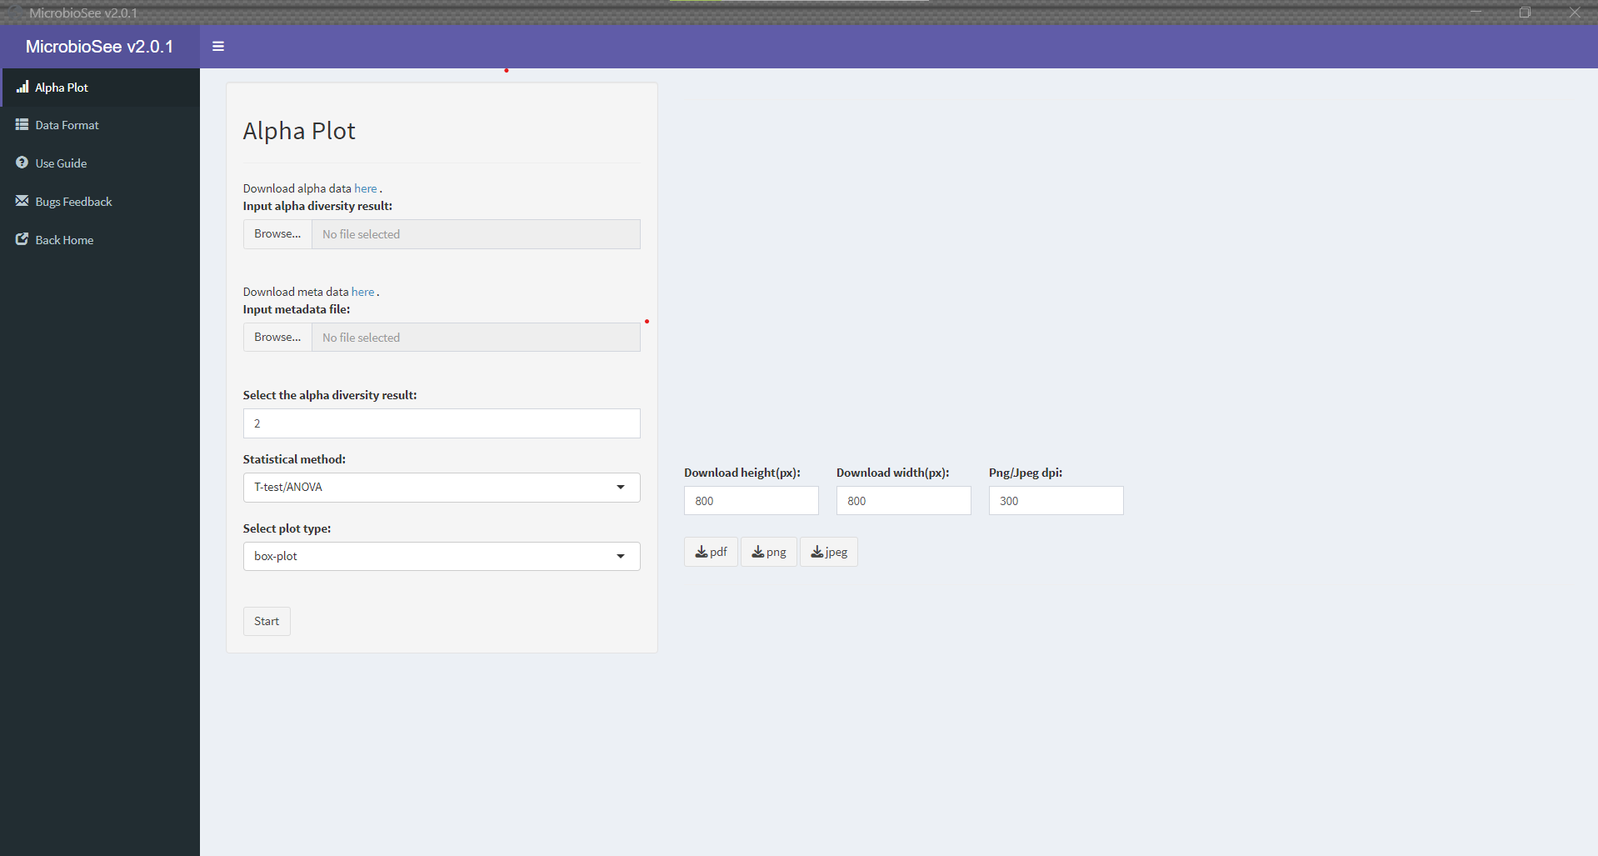
Modules
Alpha
Uses:
Visualizing species richness and diversity within samples
Assessing evenness and relative abundance of species
Identifying dominant or most abundant species
Comparing diversity patterns across samples/environments

Slide 9
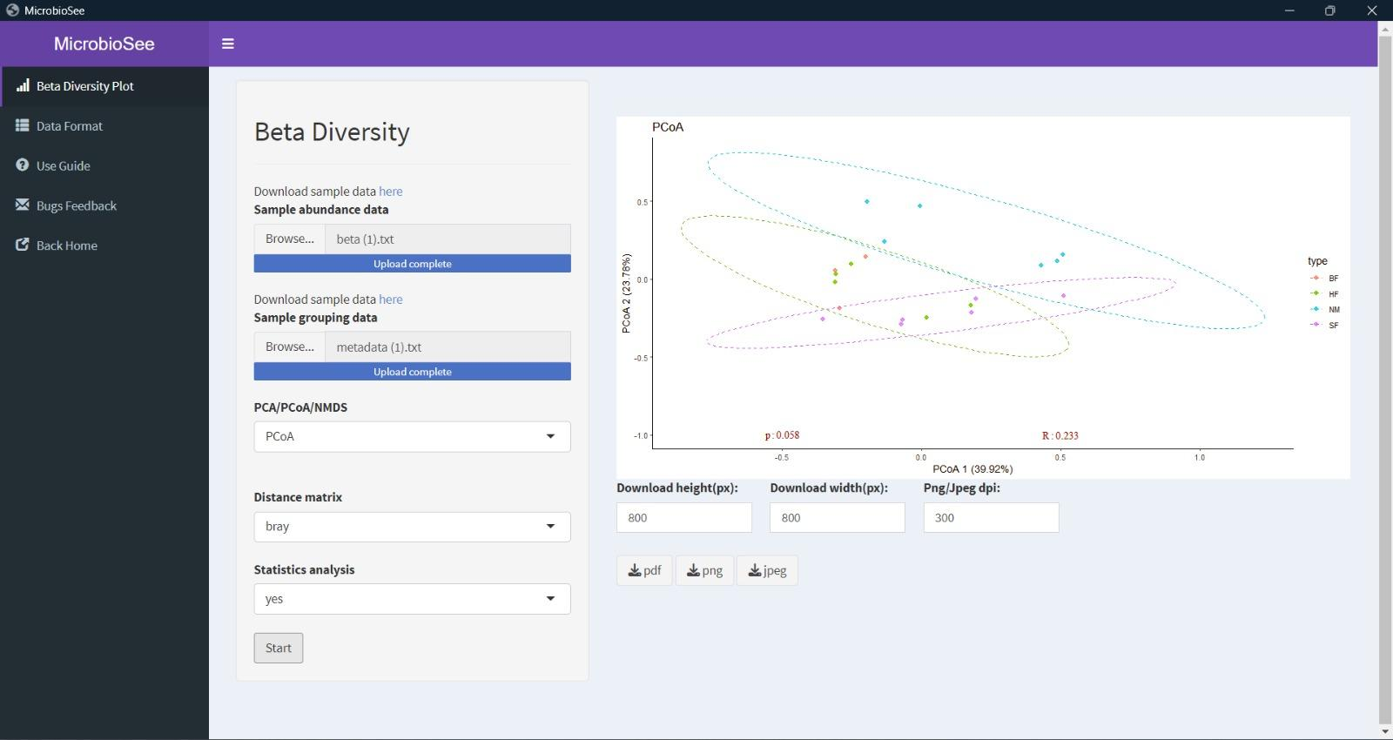
Modules
Beta Diversity
Uses:
Comparing microbial community compositions across samples/environments
Identifying environmental drivers shaping community structures
Assessing ecological processes influencing community assembly
Monitoring dynamics and responses to perturbations

Slide 10
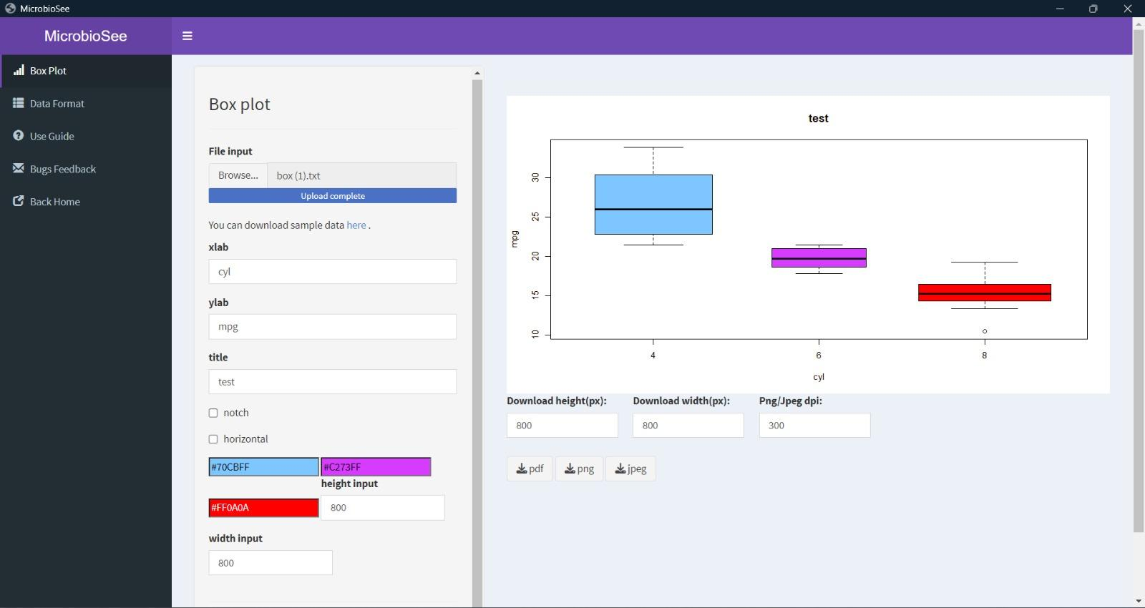
Modules
Box Plot
Comparison of central tendencies and dispersion
Identification of statistically significant differences
Detection of outliers or anomalies
Exploration of patterns and hypothesis generation

Slide 11
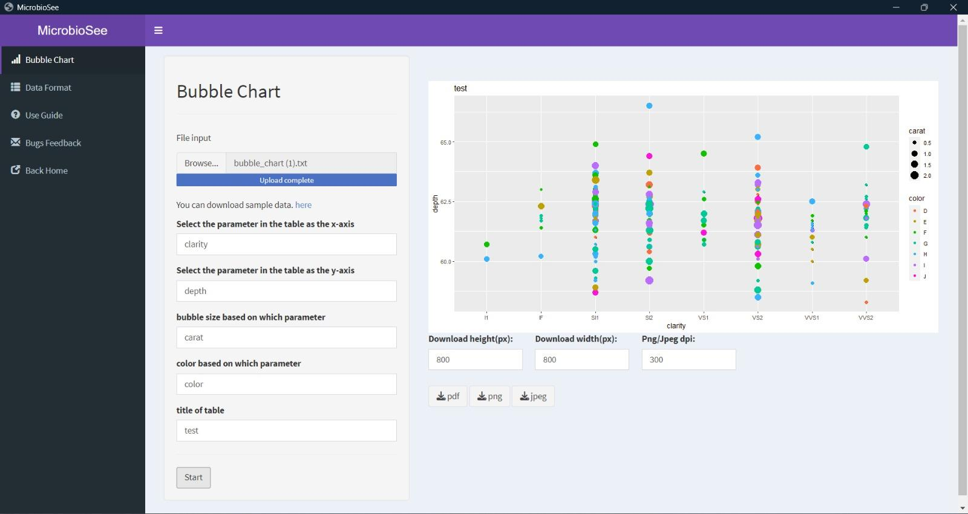
Modules
Bubble Chart
Uses;
Visualizing relative abundances of taxa across samples
Identifying dominant and rare taxa within communities
Comparing taxonomic compositions between different samples or conditions

Slide 12
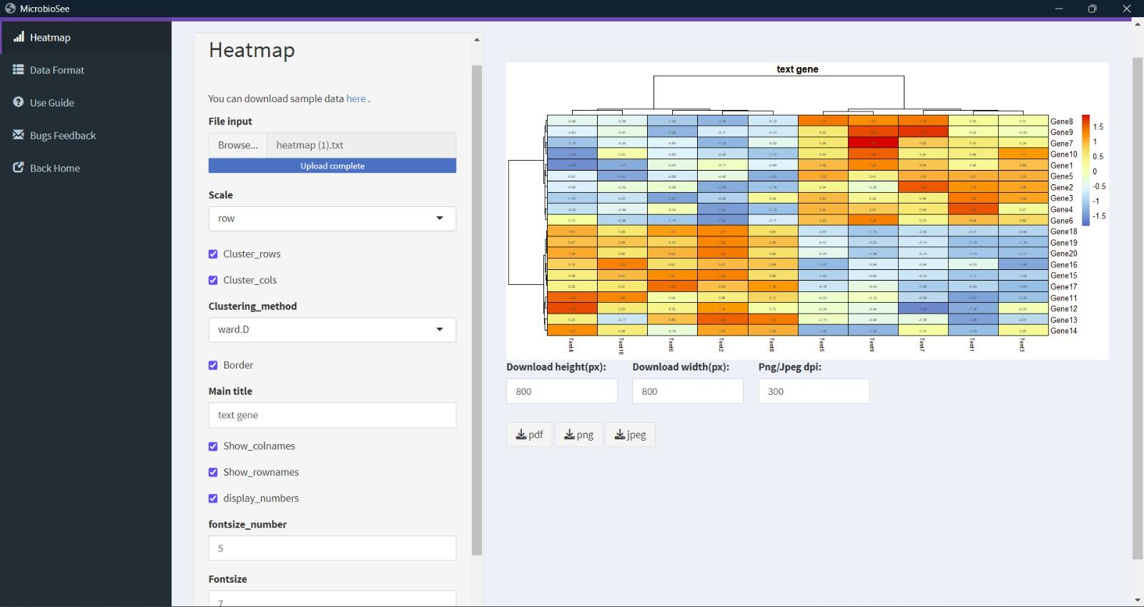
Modules
Heatmap
Uses:
Visualizing and comparing the abundance patterns of taxa across multiple samples
Identifying clustering patterns or similarities in community compositions
Exploring relationships between taxa and environmental/experimental variables
Detecting hotspots or areas of high or low abundance

Slide 13
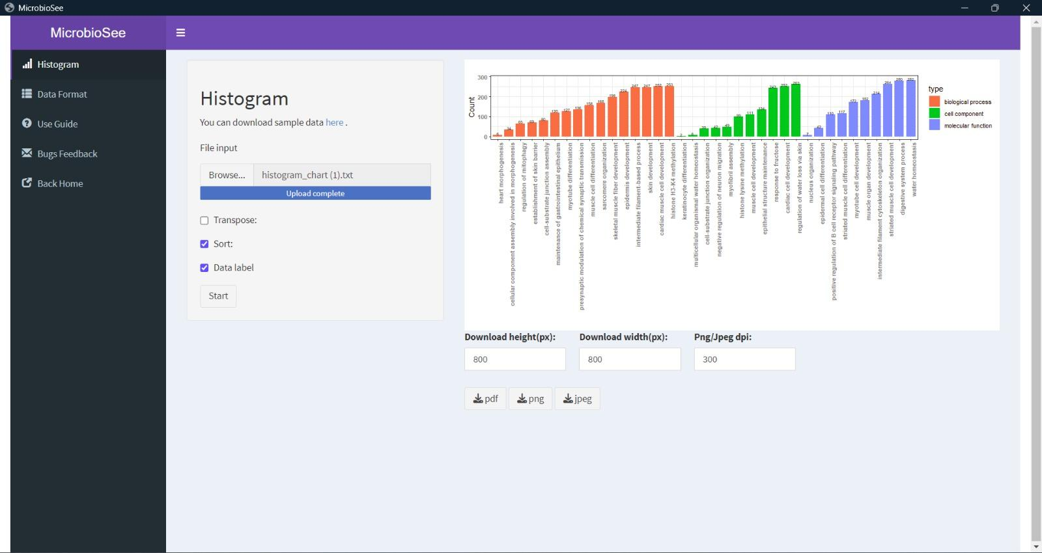
Modules
Summarize metagenomic data distribution, aiding in understanding its characteristics.
Help to detect errors and contamination, ensuring data reliability.
Illustrate taxonomic abundance, revealing the composition and diversity of microbial communities.
Enable comparison of features across samples, highlighting differences or similarities in microbial communities.
Histogram

Slide 14
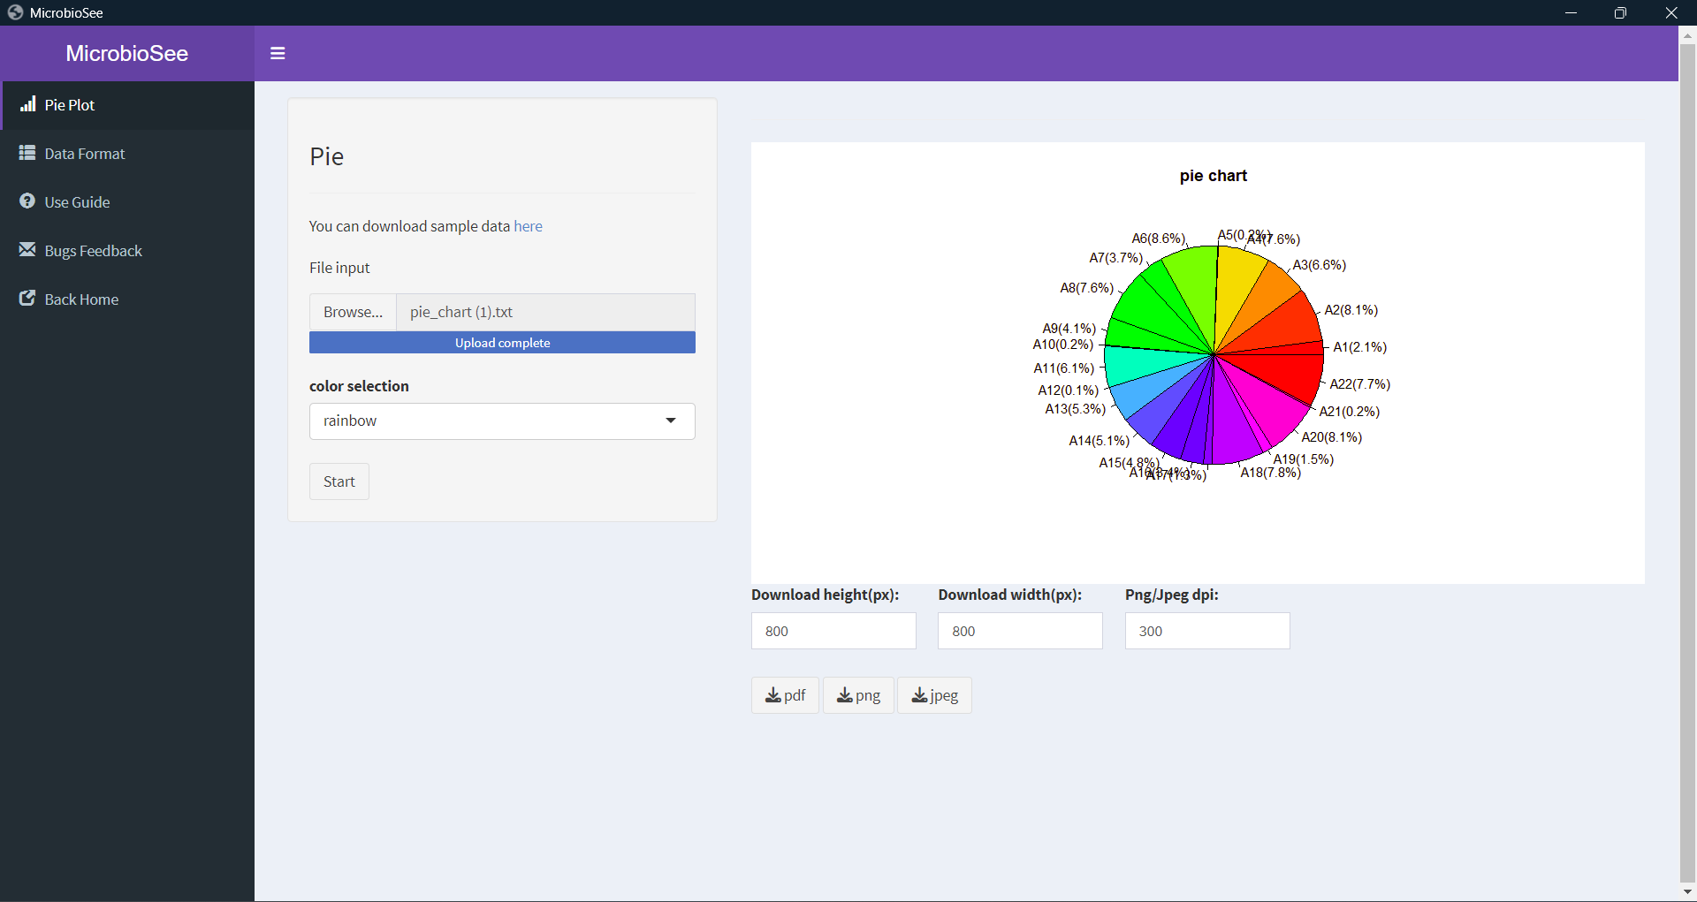
Modules
Pie chart
Uses:
Relative representation of taxonomic composition
Visualizing distribution of metabolic pathways
Identify spatial trends

Slide 15
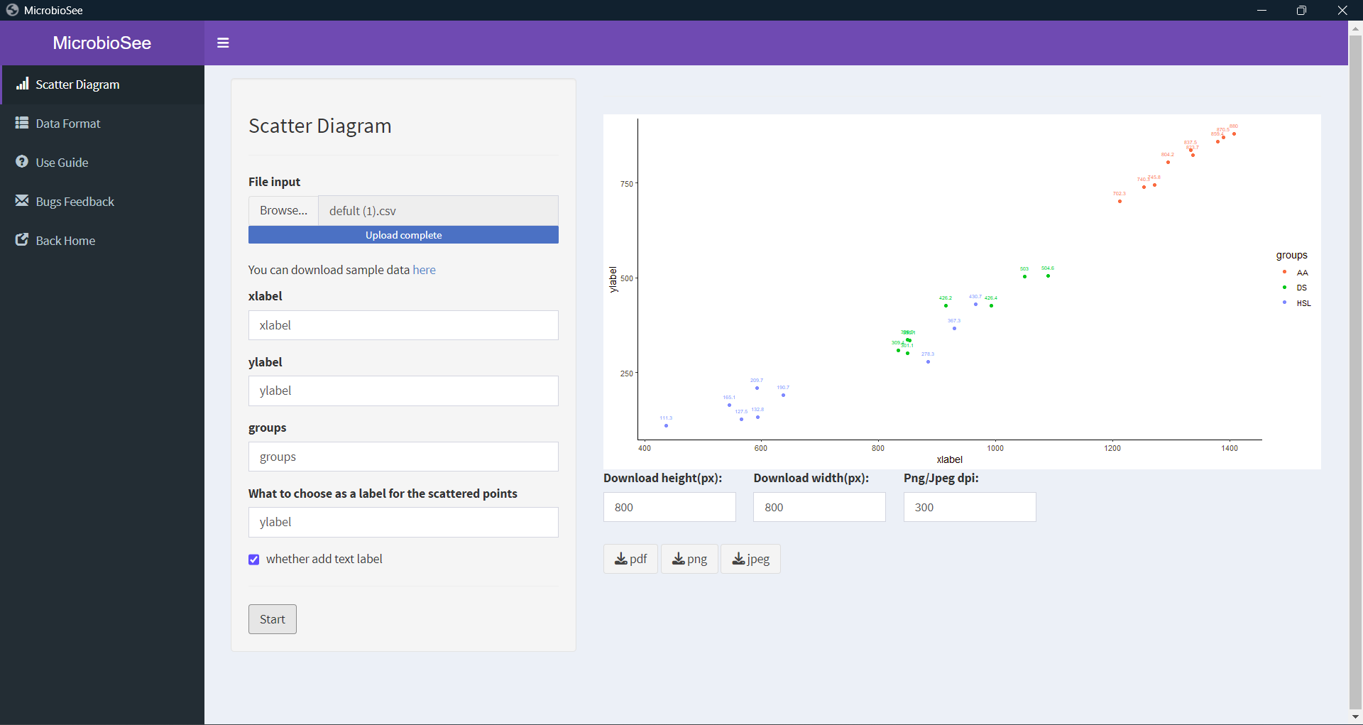
Modules
Scatter plot
Uses:
Identifying evolutionary relationships between microbial communities.
Detect outliers by identifying unusual compositions.
Compare metagenomic profiles across different conditions

Slide 16
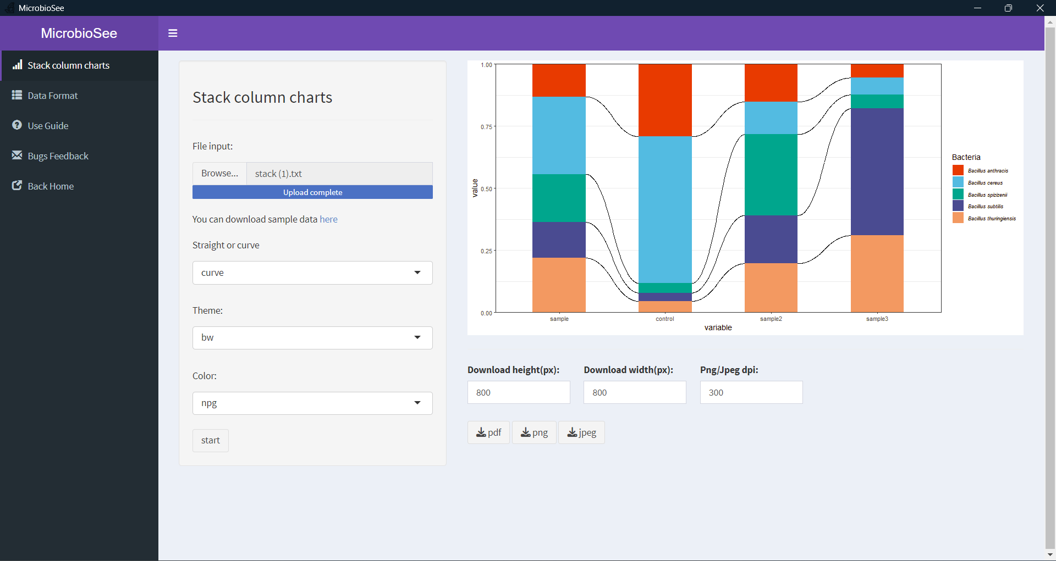
Modules
Stack
Uses:
Visualize the proportion of different microbes within a sample.
The layered representation helps to explore different patterns among complex hierarchies.

Slide 17
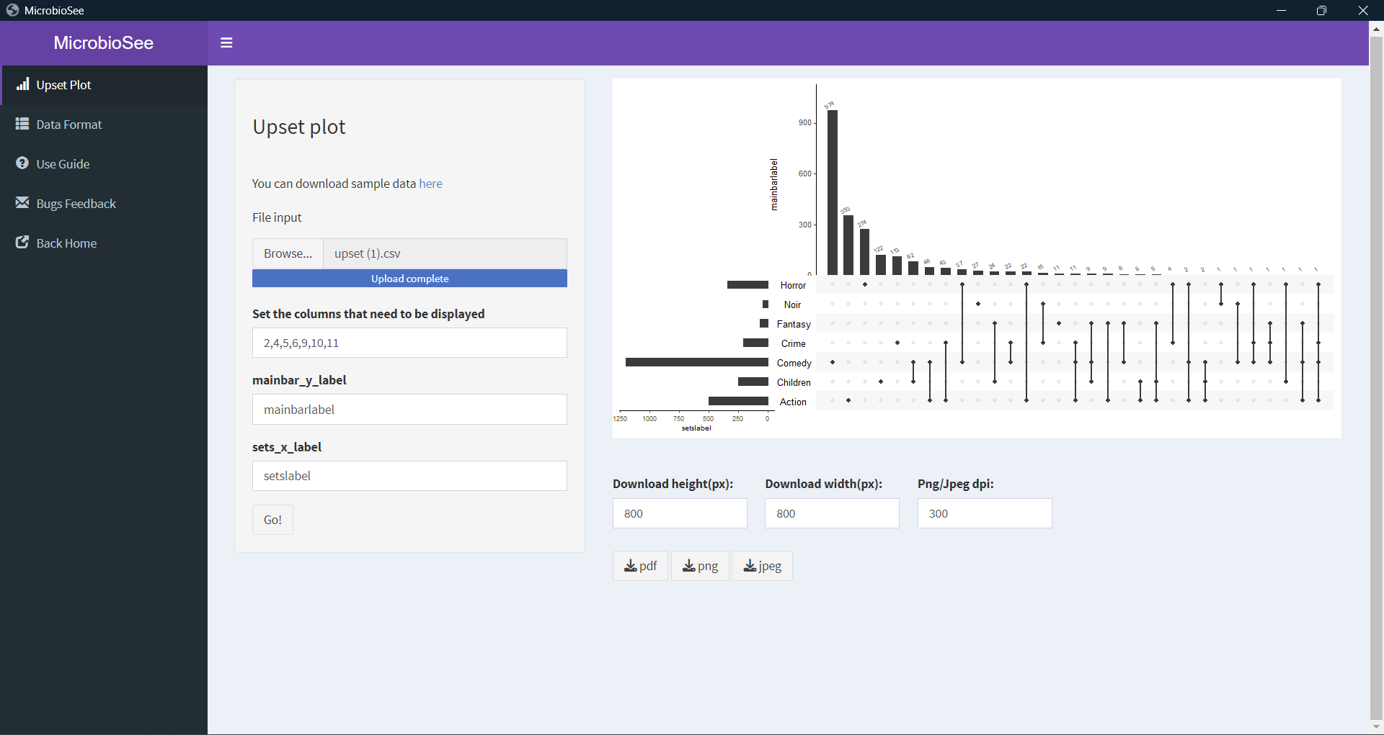
Modules
Upset Plot
Uses:
Better at visualizing complex and bigger datasets in comparison with traditional plotting methods
Represent different organisms detached at variable conditions.
Represent relative abundance of microbial communities.

Slide 18
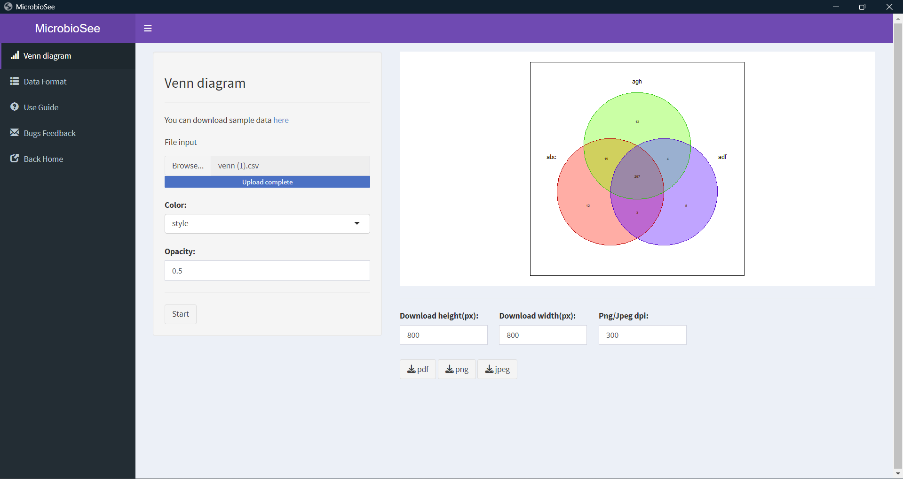
Modules
Venn
Uses:
Often used to compare genetic material across different species.
Provide quantitative information about the number of shared and unique features.
Illustrate overlaps among microbial communities.

Slide 19
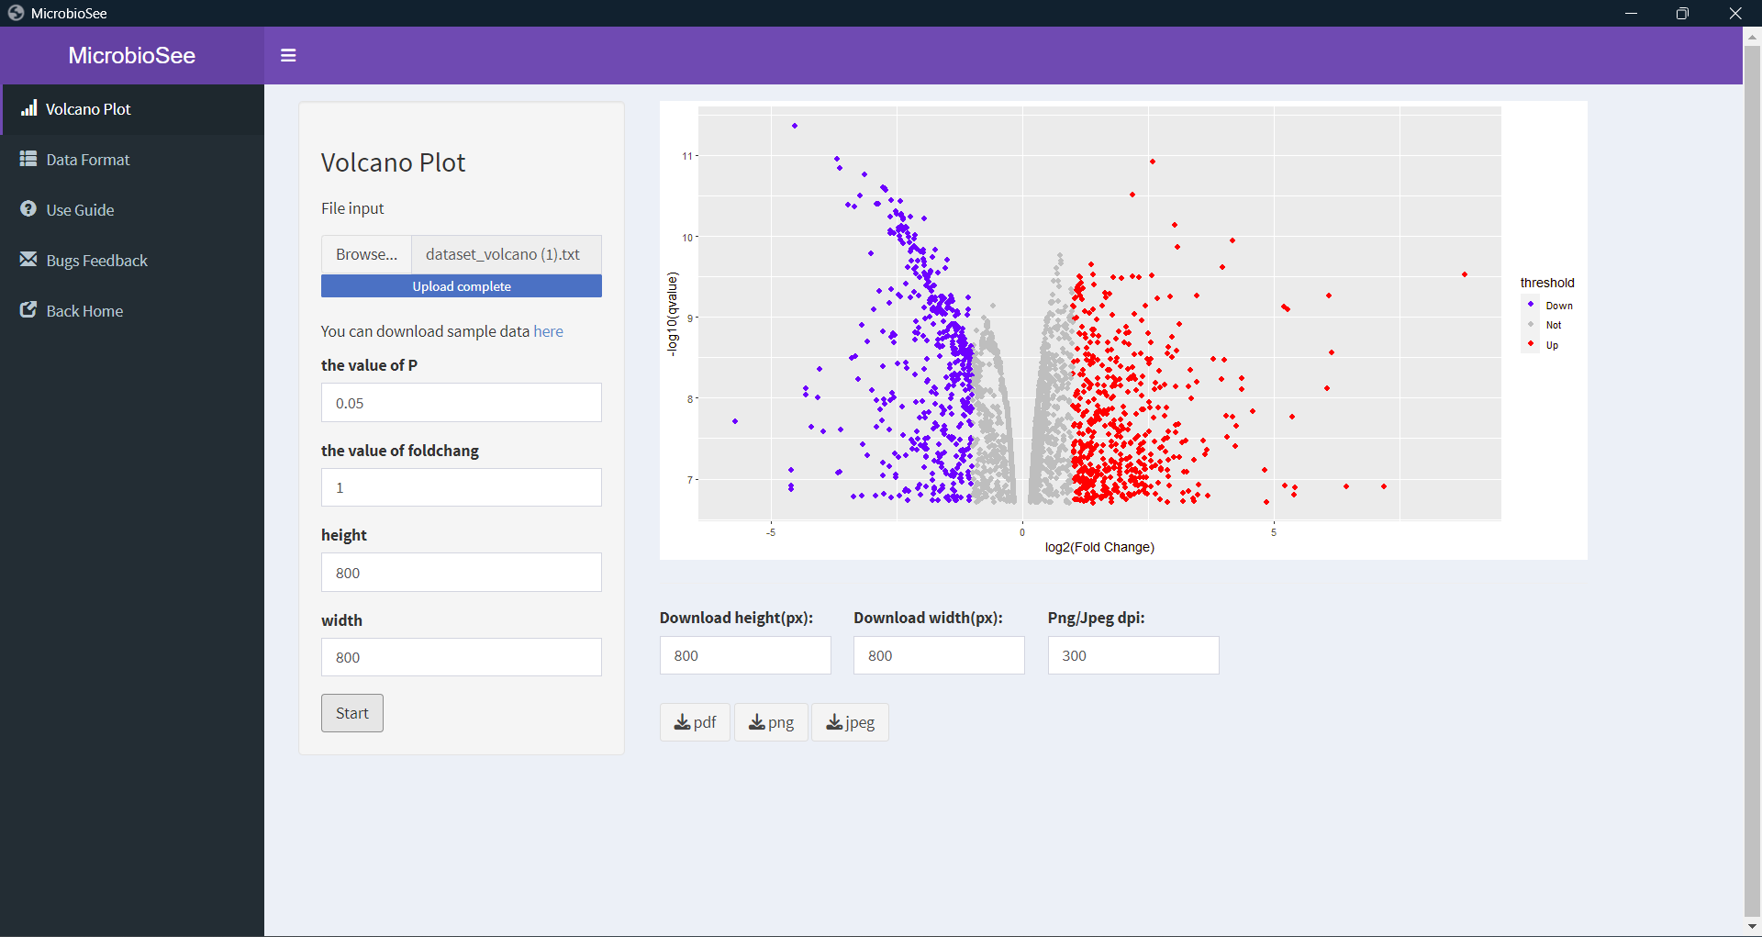
Modules
Volcano Plot
Aid in generating hypothesis regarding the roles of microbes in different conditions.
Represent the magnitude of change and statistically significant differences among different observed samples.
Identify the activity or abundance of different microbes in a sample.

Slide 20
Discussion
Challenges:
Install target package versions and all their required complex dependencies and with many errors.
Testing until the app gets adapted to the reactiveness cause by usage of Shiny.
Construct without network-independent. Run a shiny in Windows OS based on VBS code.
Future:
More functions can be added in MicrobioSee2, such as building Machine Learning model and visualizing the ROC.

Slide 21
MicrobioSee v2
How to use MicrobioSee v2 ?
Installation
Usage Guide
Bug Feedback
Notes:
I present

